Slide 1

Probability and Statistics
(Software Engineering)
Instructor
Dr. Bakhtawar

Slide 3
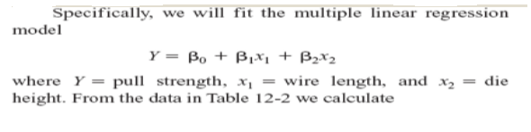

Slide 4
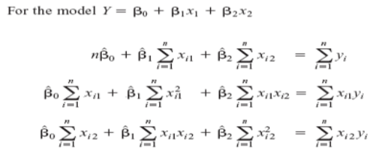

Slide 6
Thank you!

